Slide 1
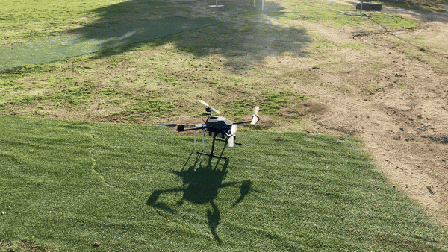

Applications of Autonomous Drones for Non-Terrestrial Networks in Remote Areas
By: Andrés Navarro Pedregal
Tutor: José Alberto Hernandez Gutiérrez
March 11, 2025. Leganés, Madrid, Spain
Dual Bachelor in Data Science and Engineering and Telecommunication Technologies Engineering

Slide 2
Table of contents
01
02
03
04
05
06
Introduction & Objectives
Technical Details
Building the Drone
Building the System
Flight Tests
Conclusions
Andres Navarro Pedregal

Slide 3
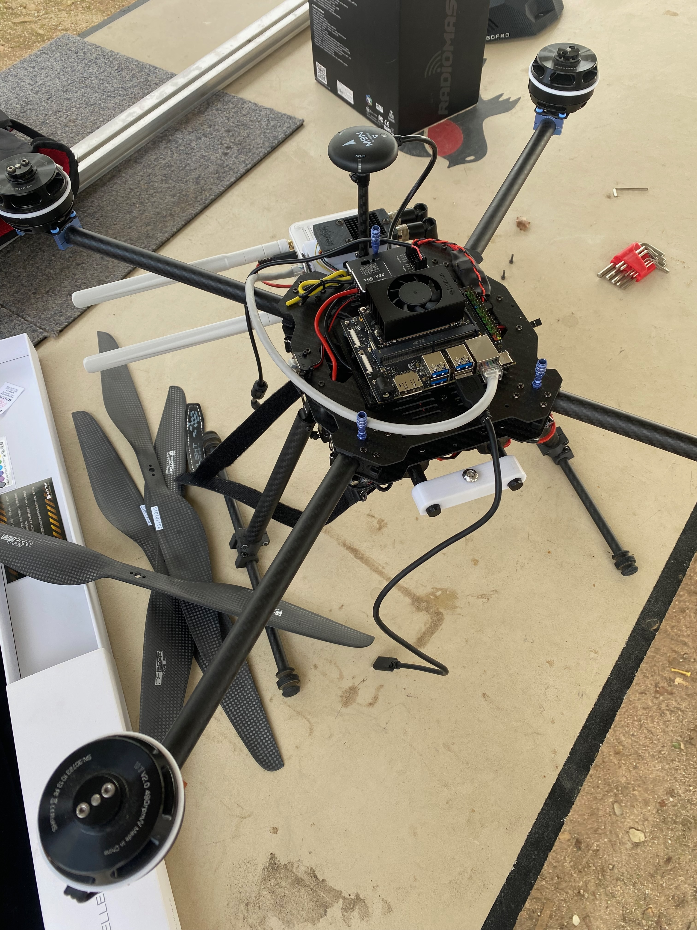
Project
Create a UAV for NTN applications
Research different applications UAVs
Part of a research project from the Telematics Department @ UC3M funded by the 6G Integration 3
Andres Navarro Pedregal

Slide 4
Objectives
Build a budget and modular UAV for research
Adaptable to different research purposes for NTNs
Propose multiple use-cases (e.g. human rescue)
Andres Navarro Pedregal

Slide 5
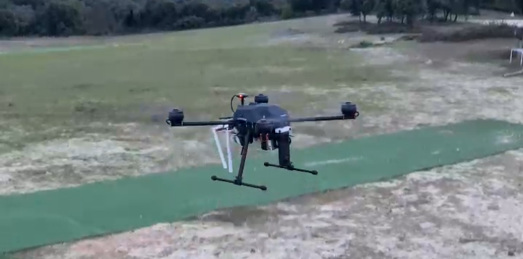
Characteristics
Weight: 6.5KG
Range: Up to 40Km
Flight time: 25-35 minutes
Autopilot capabilities
Retractable landing gear
ML & AI Intelligence Integrated
Andres Navarro Pedregal

Slide 6
Drone Architecture
360 Camera
Onboard
computer
5G Router
PDB
Battery
Telemetry Control
Motors
ESC
Flight Controller
GPS
Andres Navarro Pedregal

Slide 7
Main components
Frame | Tarot X690 | 17 inch propellers
Motors | T Motor U7 490kv | Up to 3kg per motor
Esc | TMotor Flame 70A LV
Flight controller | Pixhawk 6c | Using Ardupilot
GPS | Holybro M9N | 1.5m CEP precision
Battery | Tattu 4s 22Ah
Radio link | RFD868x | With mavlink telemetry
Controller | Radiomaster TX16S MAX
2599 €
Andres Navarro Pedregal
Notes:
poner precios

Slide 8
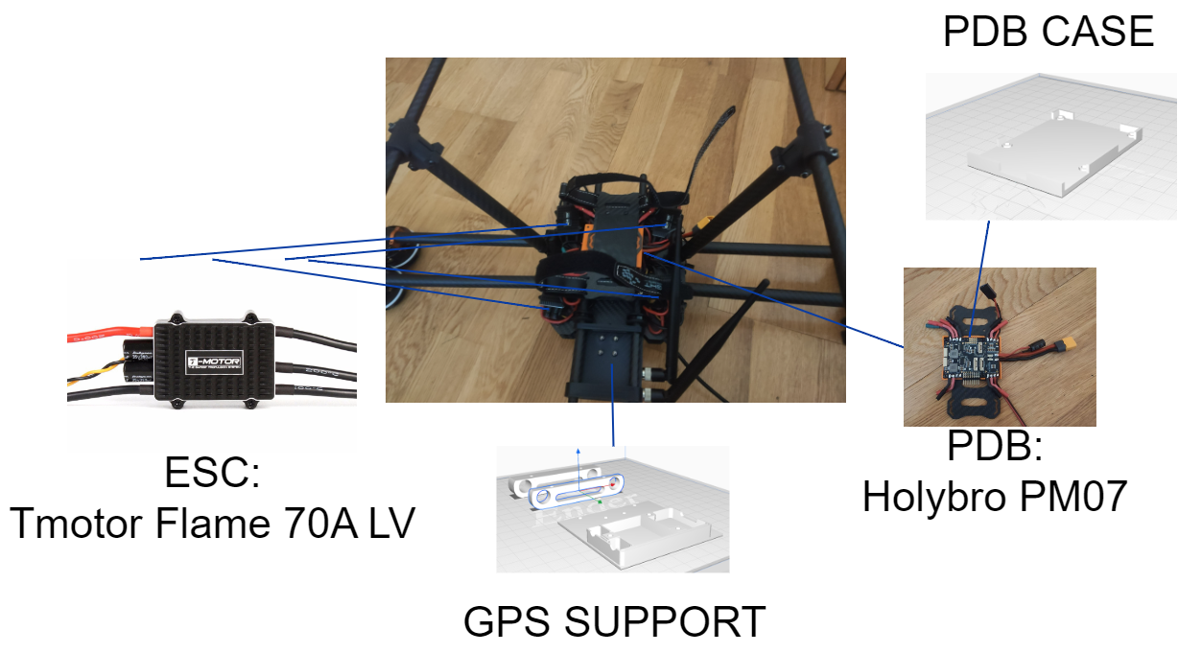
Components
Andres Navarro Pedregal

Slide 9
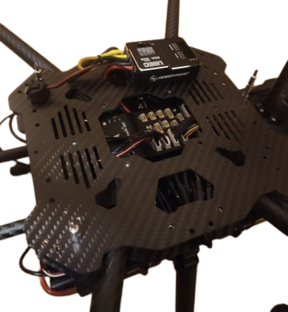
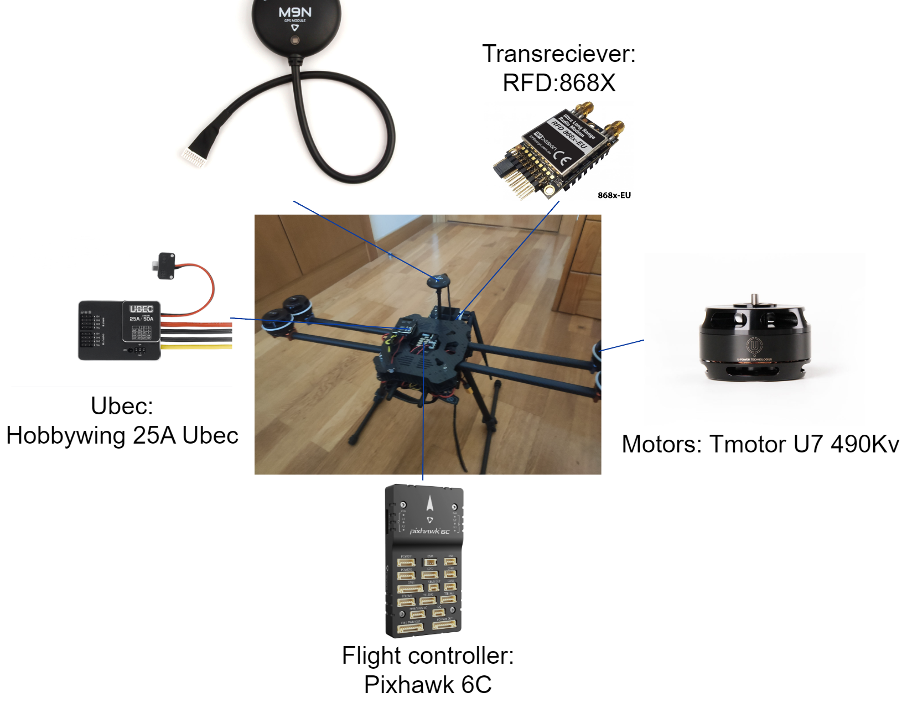
Components
Andres Navarro Pedregal

Slide 10
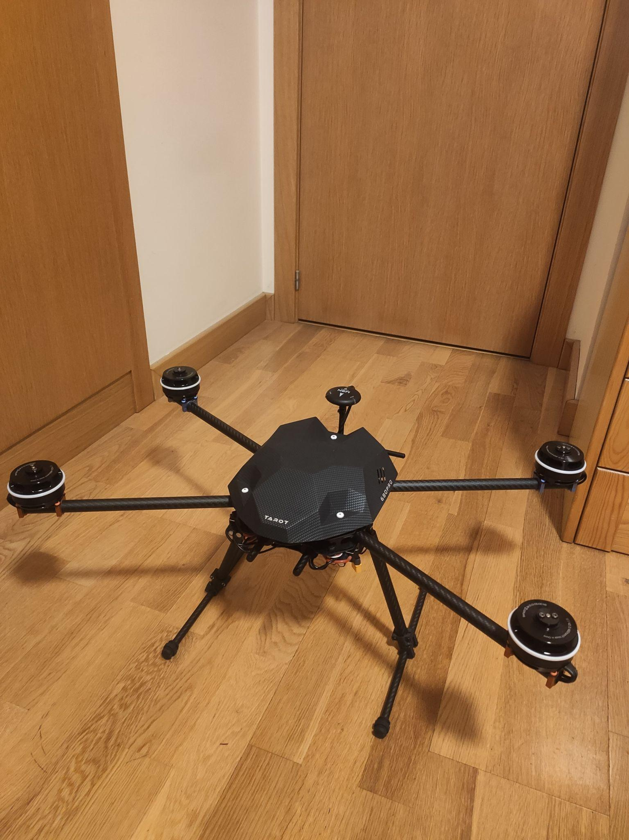
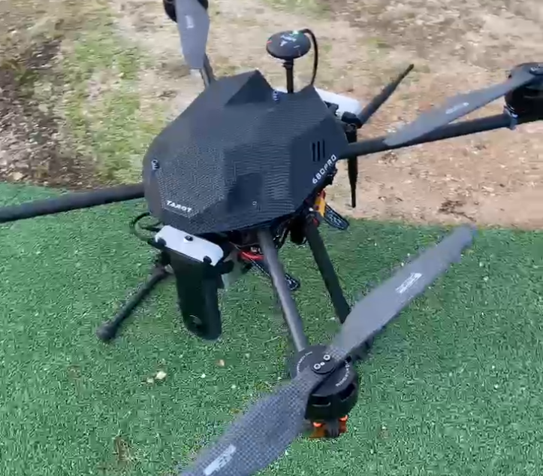
Full Build
Andres Navarro Pedregal

Slide 11
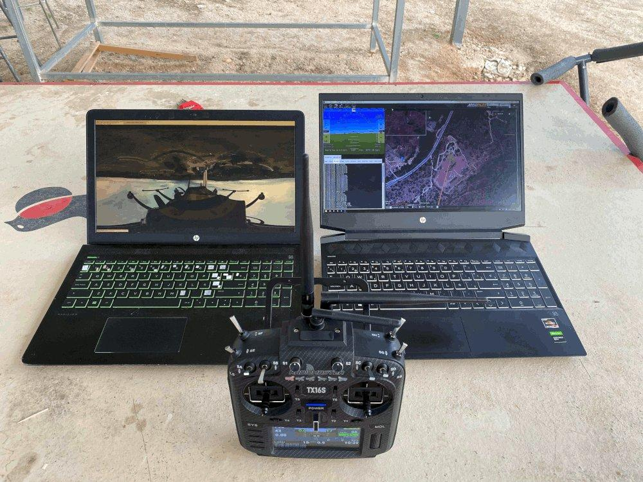
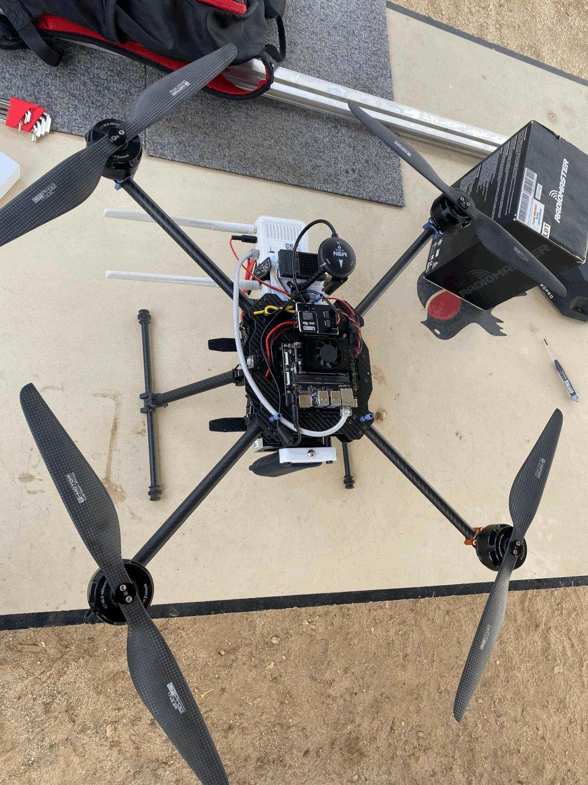

High Level Overview
Server & Ground Station
LLMs
Drone
Andres Navarro Pedregal

Slide 12
5G NTN Components
Onboard Computer | Jetson Orin Nano | 8GB RAM 5.3 TFLOPs
360 camera | Ricoh Theta X | 4K 30fps USB livestream
4G/5G router | (GL-X750V2) Smart WiFi | Dual band, OpenWrt
1804 €
Andres Navarro Pedregal
Notes:
footer uc3m, andres navarro marzo 2025

Slide 13
Architecture
🔍
🚨
Object Detection
Alert
📷
💻
Server
360 camera
Object Detection
🤖
🌐
LLM Integration
Drone
VPN Tunnel
Andres Navarro Pedregal

Slide 14
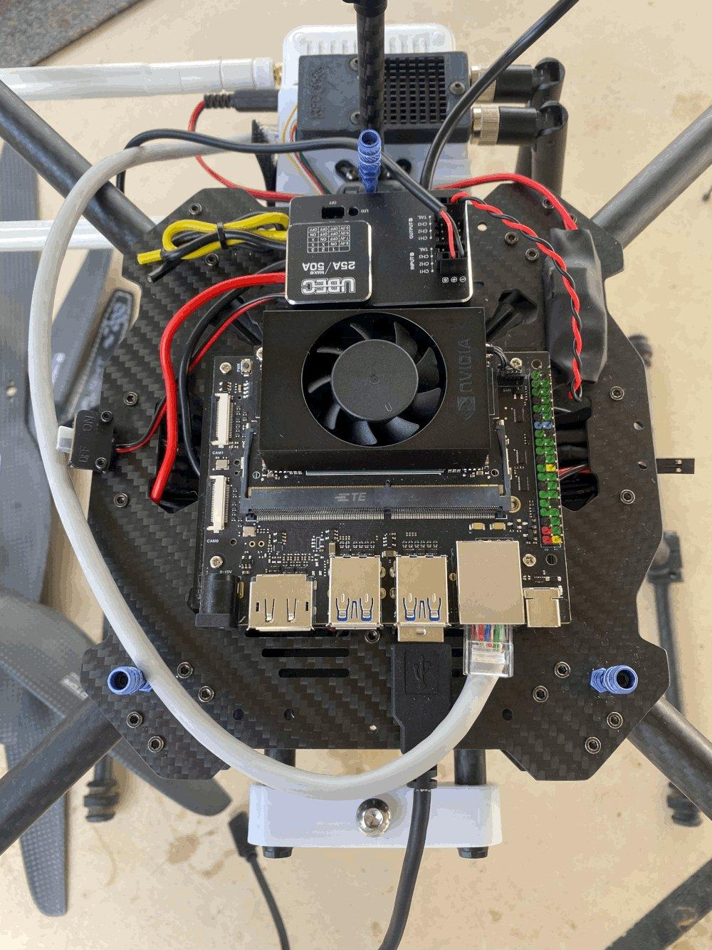
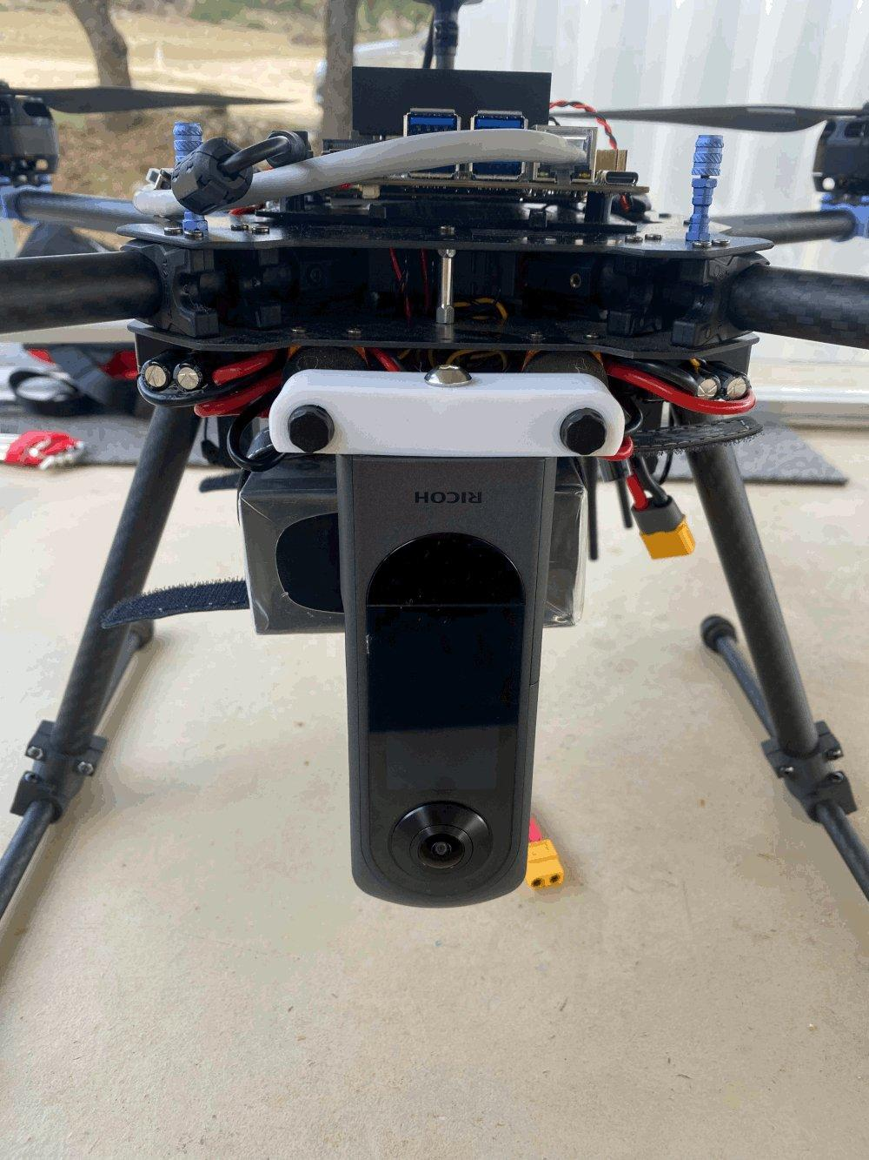
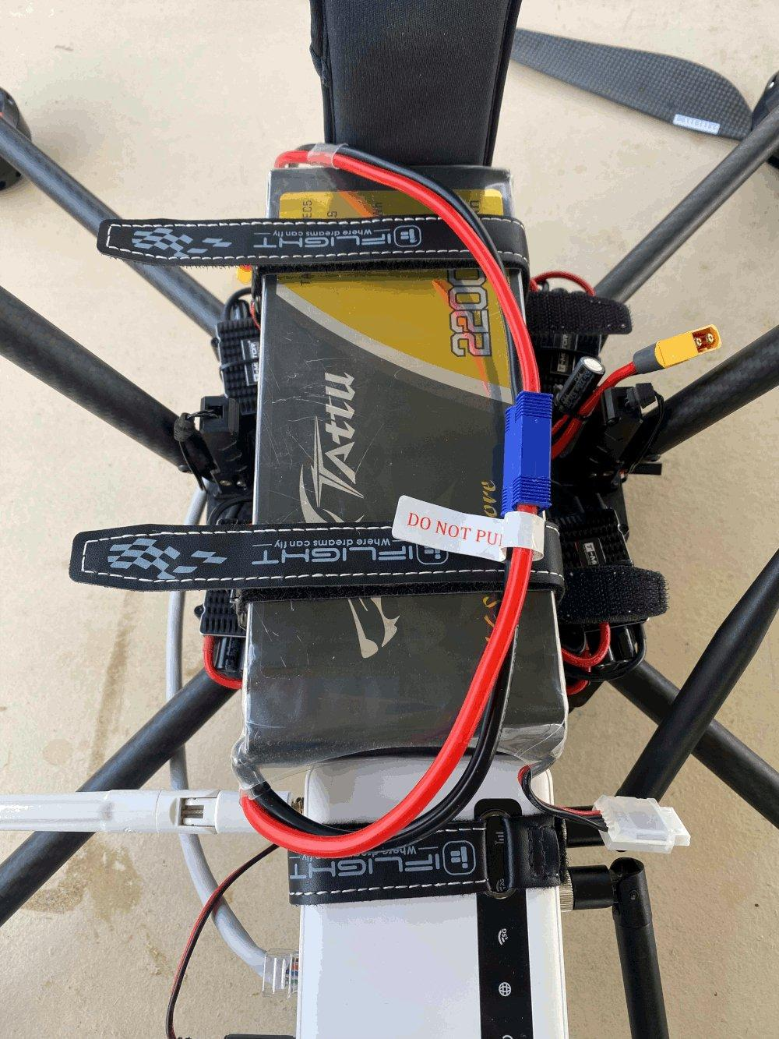
Drone
Edge Computer with GPU
360 Camera
Router
Andres Navarro Pedregal

Slide 15
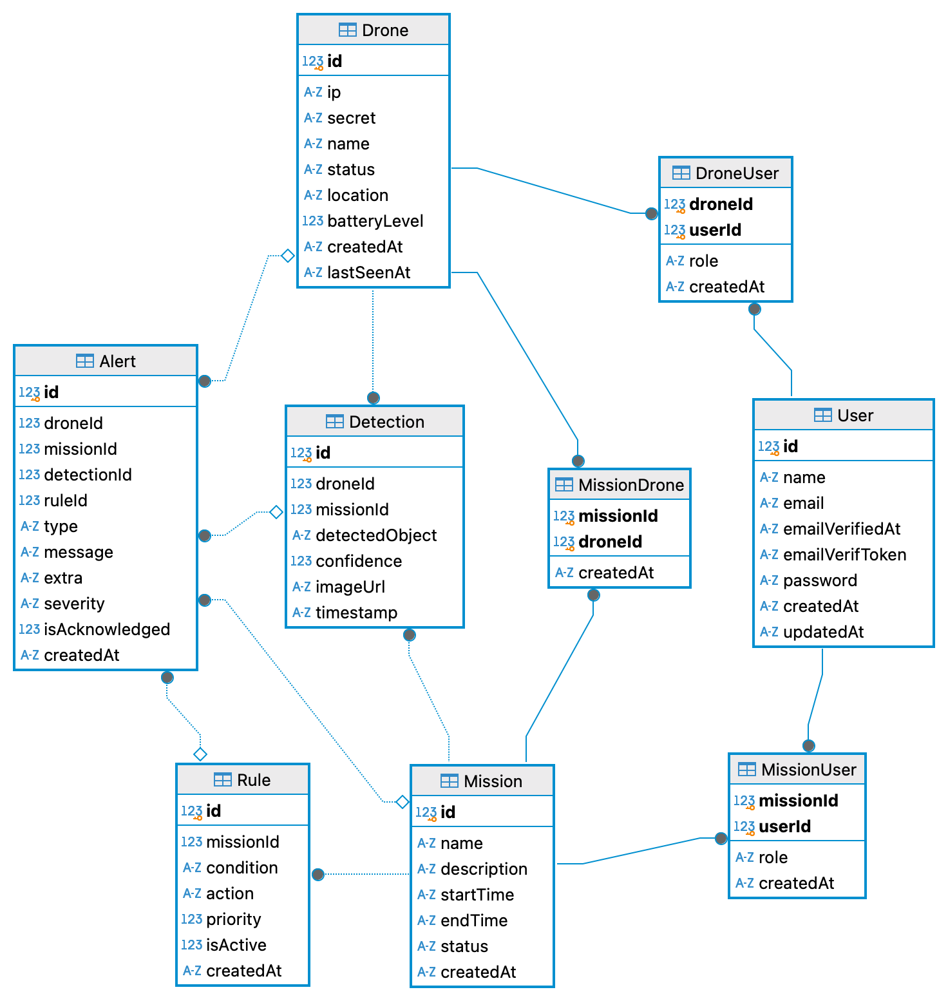
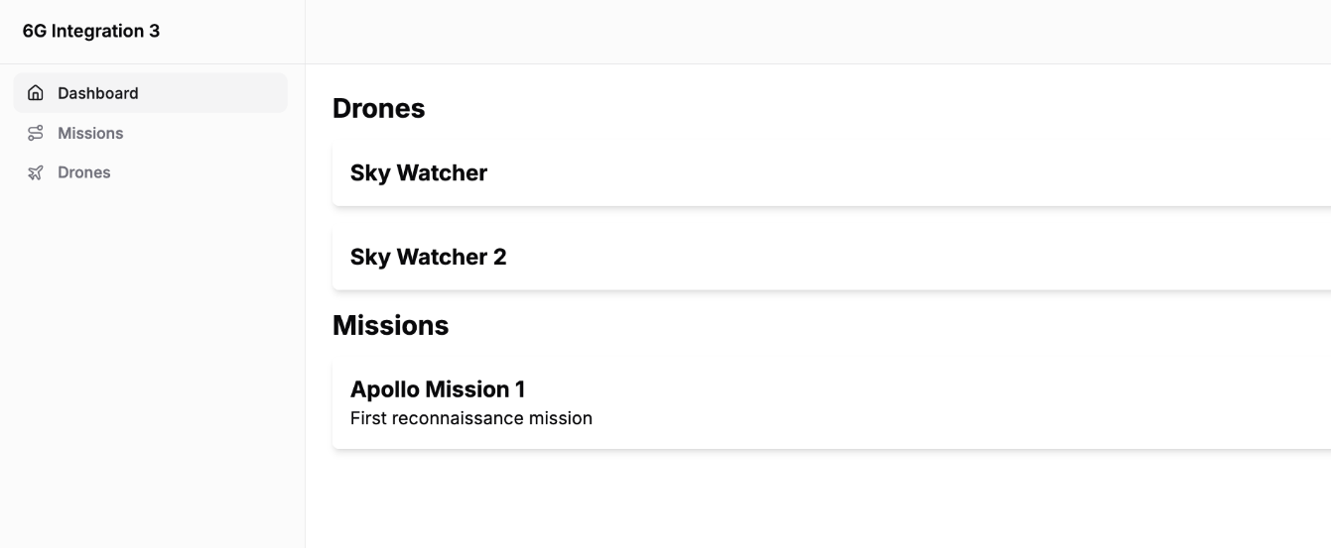
Server
Andres Navarro Pedregal

Slide 16
DB Schema
📸
🚁
🚁
🚁
Detection
🚨
Drone
Alert
🟰
🗺️
🧍
🗺️
Rules
User
Mission
Andres Navarro Pedregal

Slide 17
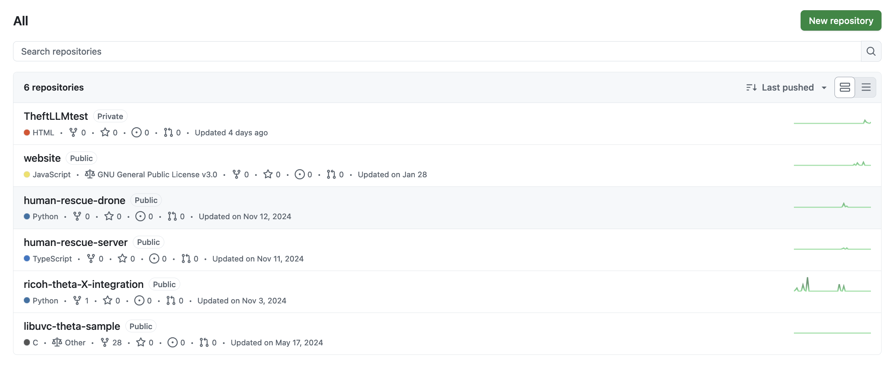
Open Source Code
Code can be found in: https://github.com/orgs/6G-Integration-3-UC3M/repositories
Andres Navarro Pedregal

Slide 18
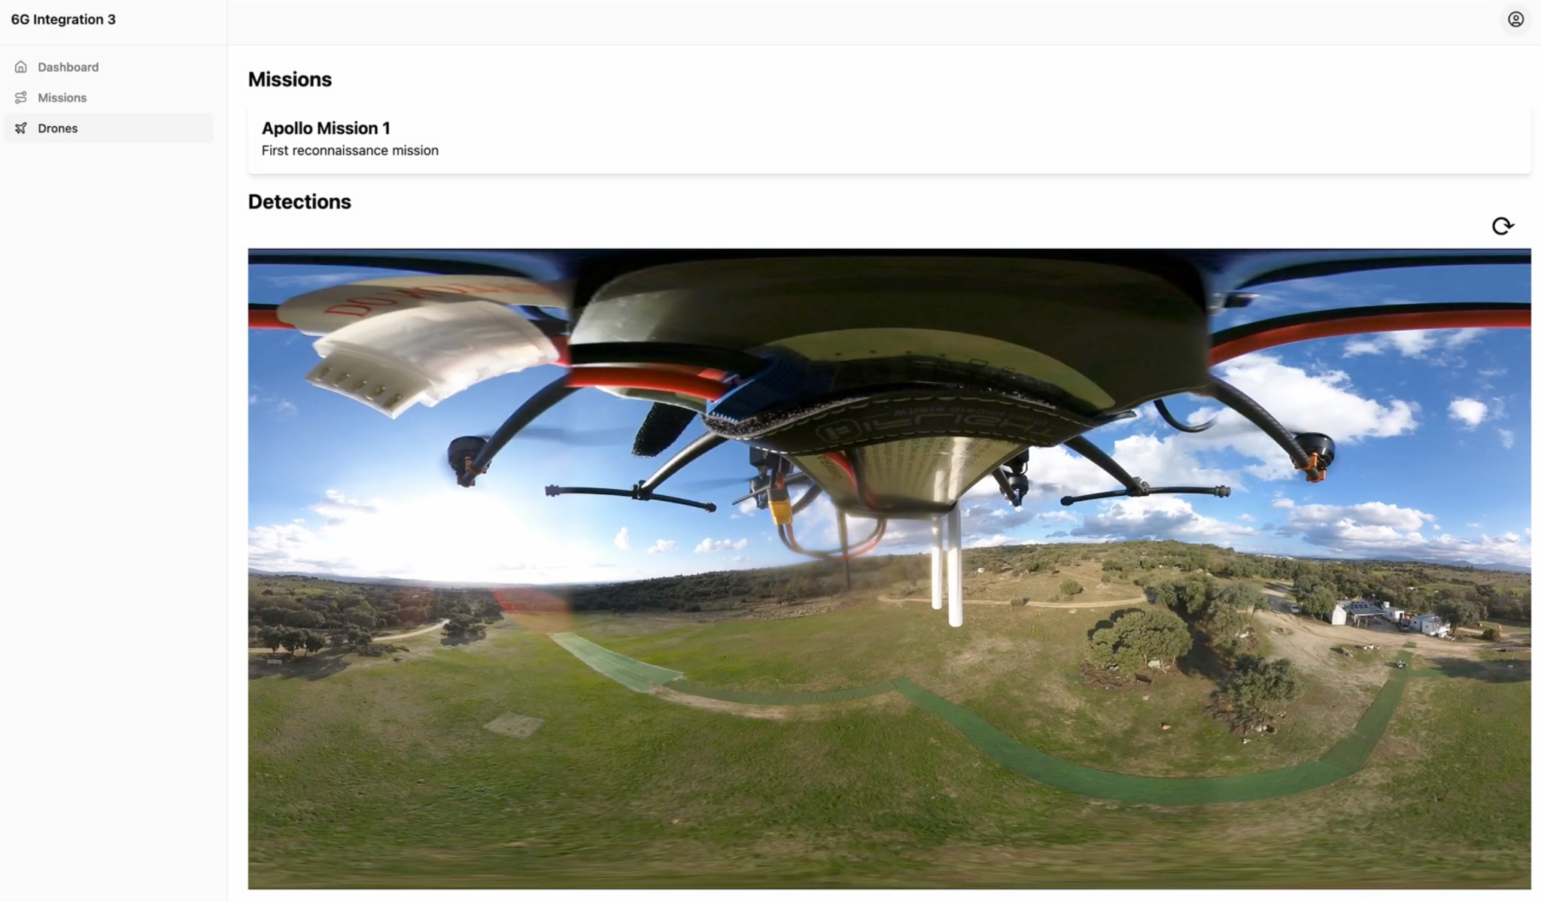
Live Connection of the Camera
Andres Navarro Pedregal

Slide 19
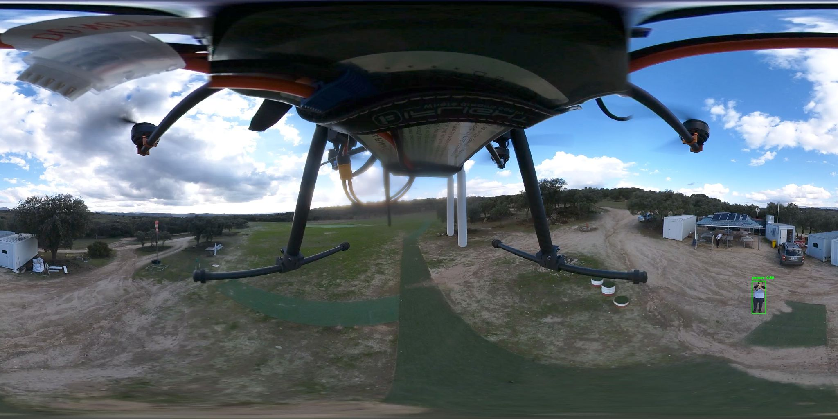
Detection Tests
Andres Navarro Pedregal

Slide 20
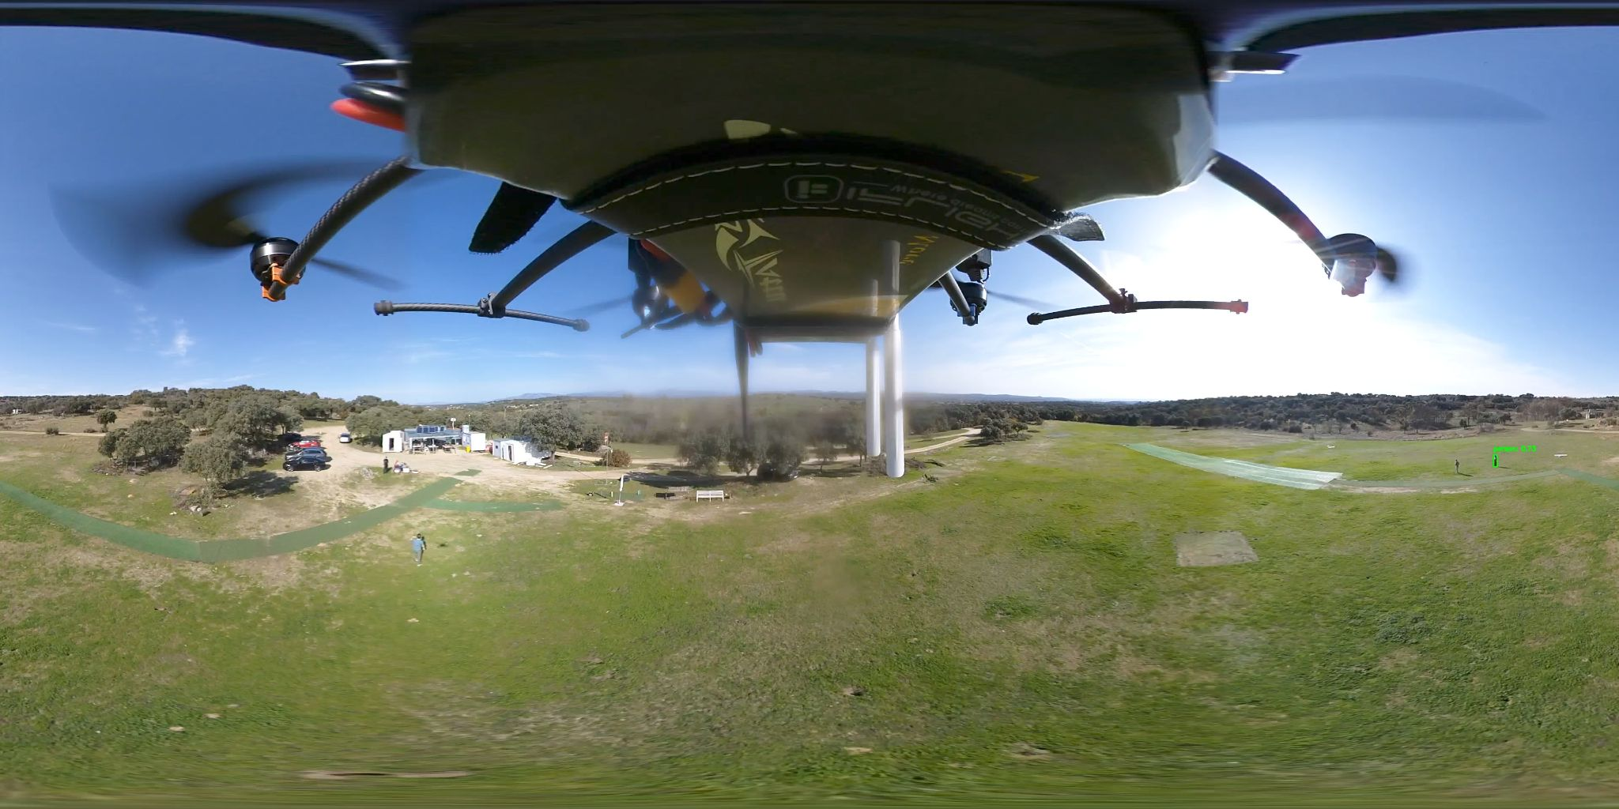
Detection Tests
Andres Navarro Pedregal

Slide 21
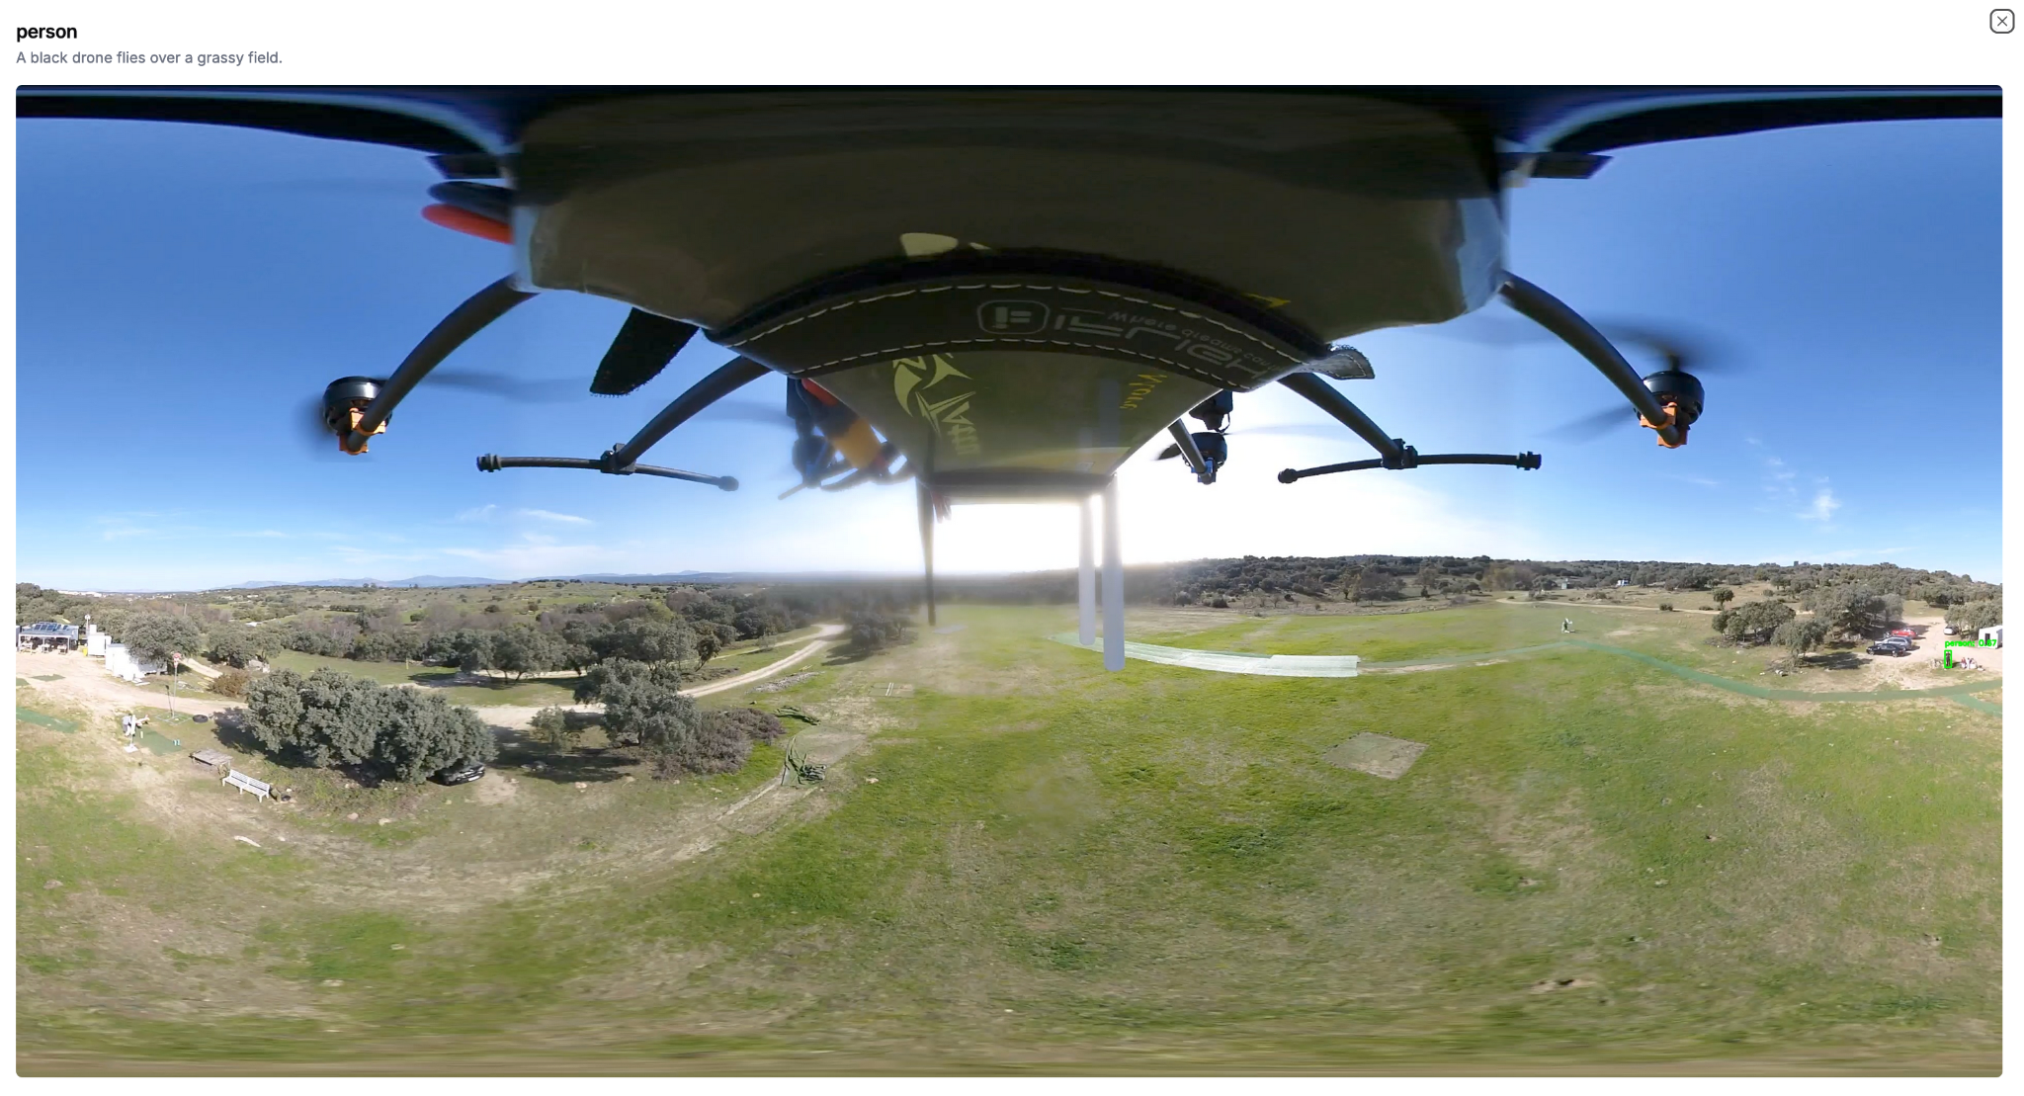
LLM functionality
Andres Navarro Pedregal

Slide 22
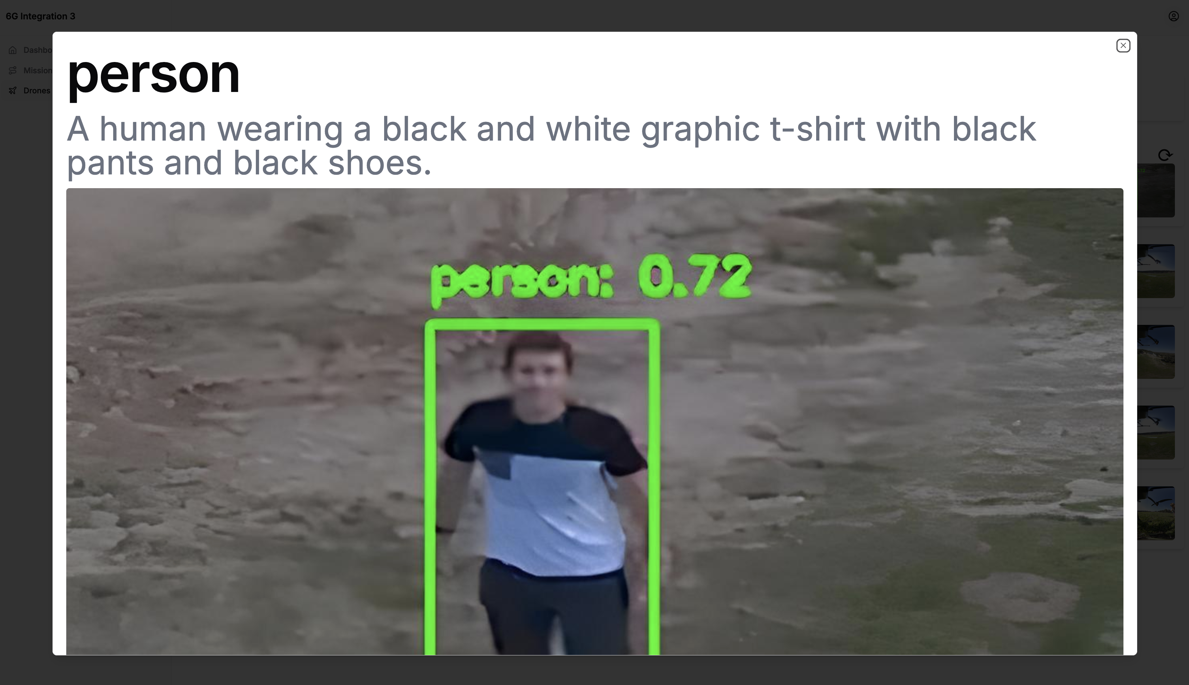
Andres Navarro Pedregal

Slide 23
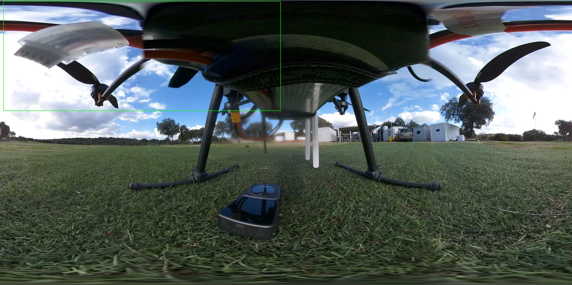
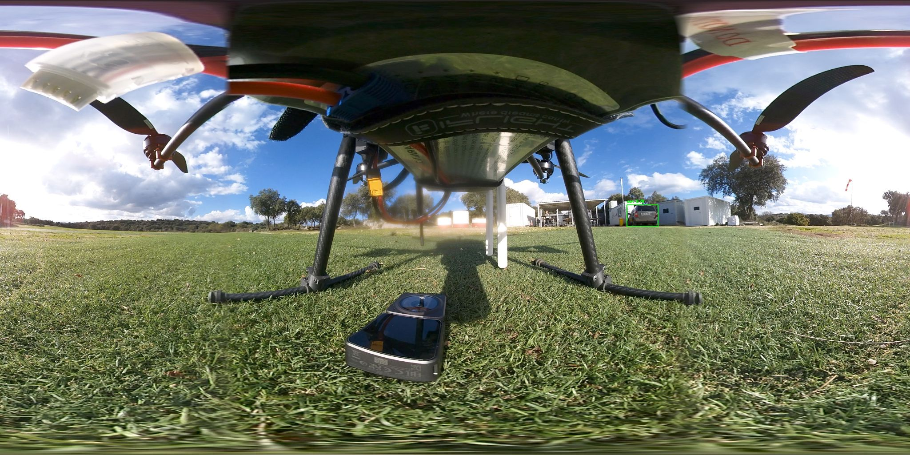
Random Detections

Slide 24
Videos
https://www.youtube.com/watch?v=IqNsVOT3uFQ
https://www.youtube.com/watch?v=kdMgwRRte-8
Andres Navarro Pedregal

Slide 25
Flight Time: 30min
Detect Humans Autonomously
Real Time Video Transmission
Andres Navarro Pedregal

Slide 26
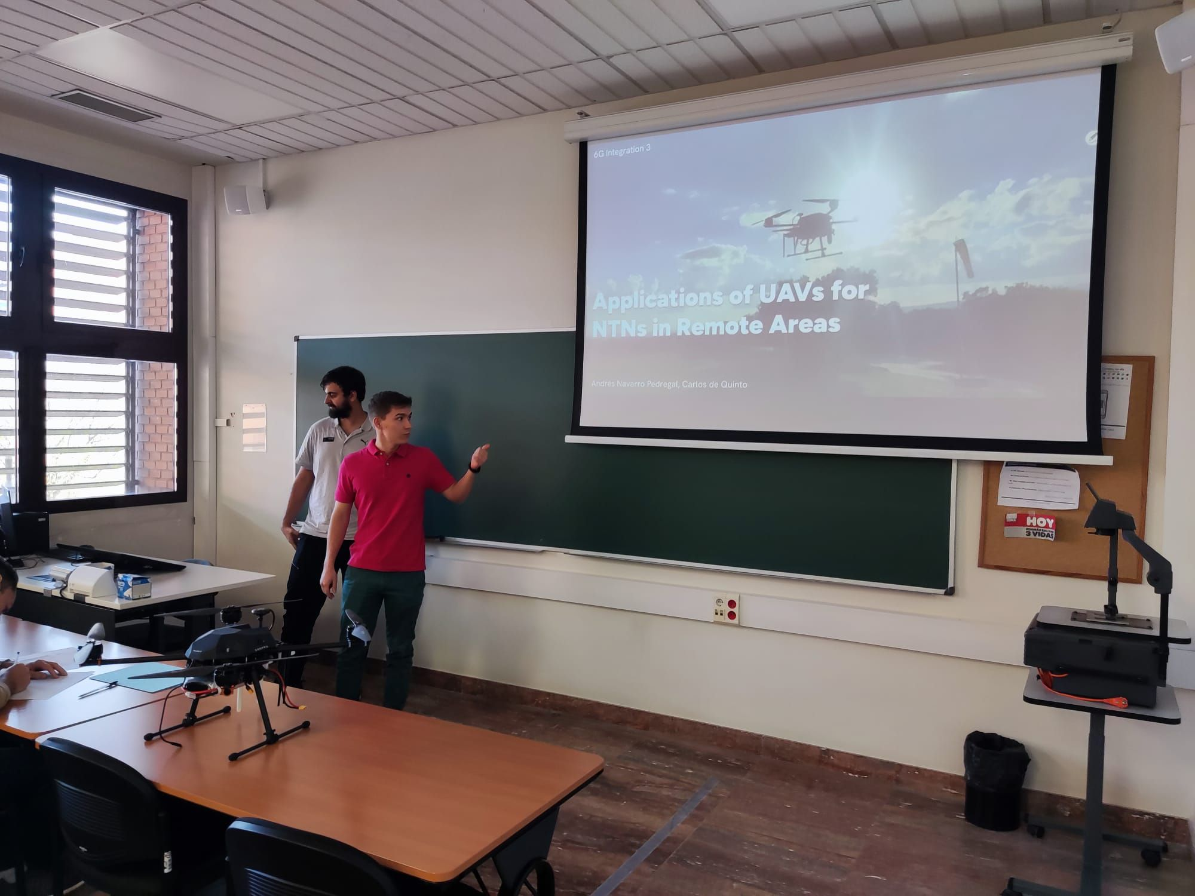
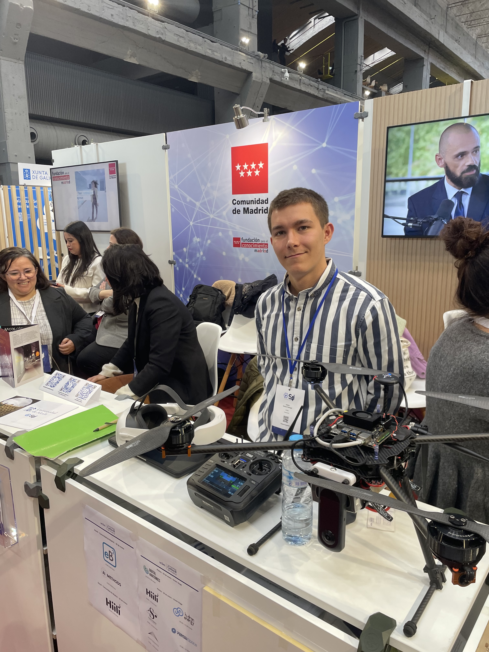

Showcase
6G Integration 3
Science for Industry (S4I) Conference
Part of a Paper
https://arxiv.org/abs/2409.19337
Andres Navarro Pedregal
Notes:
JCR

Slide 27
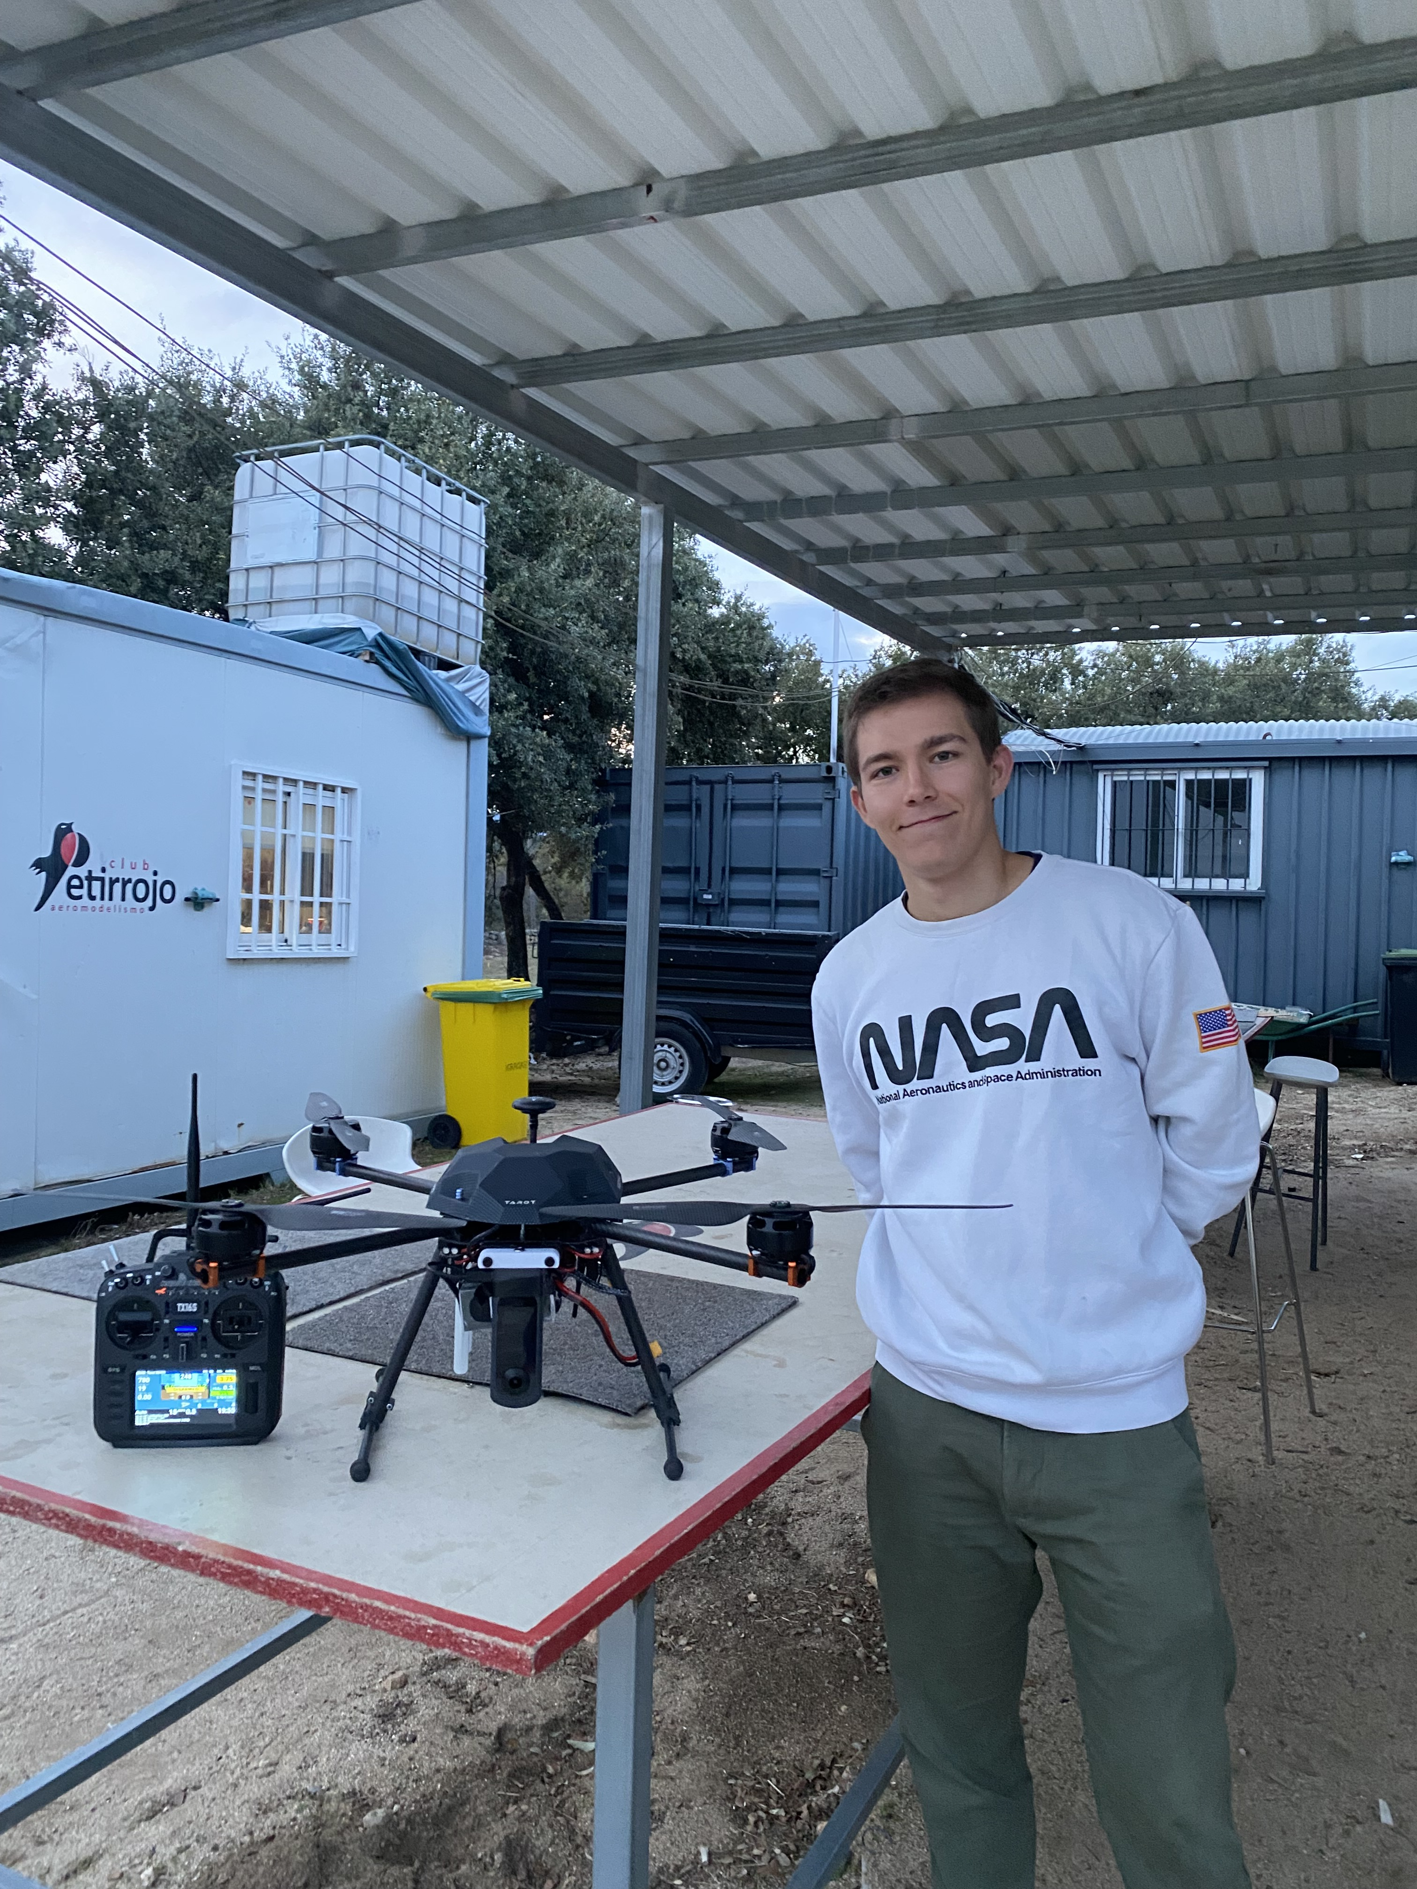
Thank you!
Any questions?

